Slide 1
Packets in Flight
CS 168 – Fall 2017 – Section 2
Notes:
V1: Ankit Mathur

Slide 2
Delays
How long does it take for your data to reach its destination?
It depends on…
how much data you’re sending and the link speed → transmission delay
your distance from the destination → propagation delay
the traffic pattern → queuing delay
how fast routers process the packet header → processing delay
Notes:
Transmission – how long it takes computer to actually put bits onto the wire. Depends on how much data you’re sending and the link speed
Propagation – normally speed of light.
Queueing – the traffic pattern. Routers are usually receiving/sending many packets on many different connections simultaneously, and this can slow down the network.

Slide 3
Delays
How long does it take for your data to reach its destination?
It depends on…
how much data you’re sending and the link speed → transmission delay
your distance from the destination → propagation delay
the traffic pattern → queuing delay
how fast routers process the packet header → processing delay
Notes:
Processing – not really gonna talk about them

Slide 4
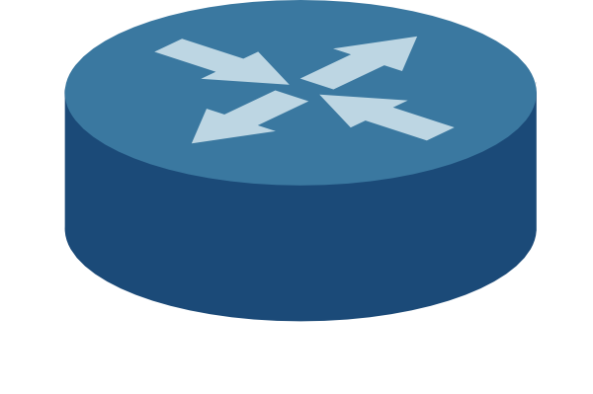

Transmission Delay
How long it takes for the all bits in the packet to get on the wire
The time between the first and last bits enter the link
Notes:
test

Slide 5
Transmission Delay
How long it takes for the all bits in the packet to get on the wire
The time between the first and last bits enter the link
Limited by the bandwidth
Notes:
Bandwidth – how many bits you can send through a wire per second

Slide 6
Transmission Delay
How long it takes for the all bits in the packet to get on the wire
The time between the first and last bits enter the link
Limited by the bandwidth
Function of packet size
Notes:
Transmission delay depends on packet size: the more data you have to send, the longer it’s gonna take to put that data onto the wire. You can only put so many bits onto the wire per second

Slide 7
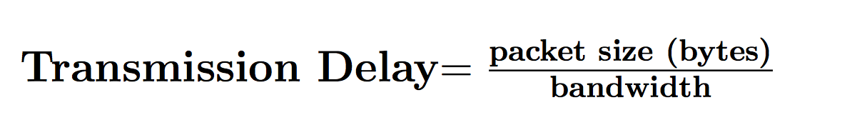
Transmission Delay
Notes:
Transmission delay depends on packet size: the more data you have to send, the longer it’s gonna take to put that data onto the wire. You can only put so many bits onto the wire per second

Slide 8
Transmission Delay: Example
Bandwidth = 4 Mbps
Packet size = 500B

Slide 9
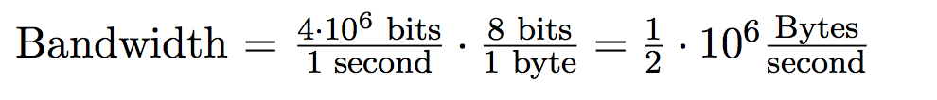
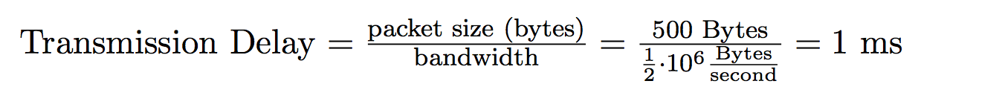
Transmission Delay: Example
Bandwidth = 4 Mbps
Packet size = 500B

Slide 10
Propagation Delay (latency)
How long it takes to transmit one bit from one end to the other
Depends on the length of the link
Limited by the speed of light (propagation speed of link)
Does NOT depend on the size of the packet

Slide 11

Propagation Delay: Formula

Slide 12

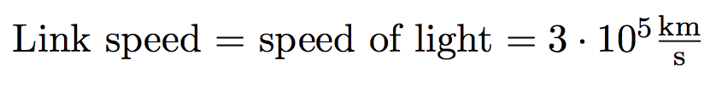
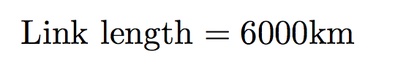
Propagation Delay: Example

Slide 13
Bandwidth Delay Product (BDP)
Now that we know the propagation delay, we can tell how many bits are “in flight” (on the link) at any time
??
??
BDP = ?? * ??

Slide 14
Bandwidth Delay Product (BDP)
Now that we know the propagation delay, we can tell how many bits are “in flight” (on the link) at any time
Bandwidth
Propagation delay

Slide 15
Packets might have to wait before they can be transmitted…

Slide 16
Queuing Delay
How long the packet waits to get transmitted on the wire
Happens when arrival rate is greater than transmission rate

Slide 17
An easy fix for queuing delay?
Naïve solution: max(arrival rate, receive rate)
Is this sufficient?

Slide 18
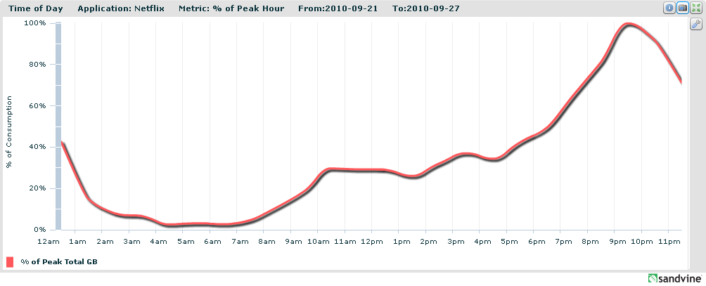
Burstiness!
Transmission rate = constant over time
Arrival rate = not constant over time
Netflix Traffic, circa 2010

Slide 19
Burstiness and Queues
How does burstiness affect queuing delays?
What happens when the queue is full?

Slide 20
Queues
How does burstiness affect queuing delays?
Bursty flows tend to increase queuing delay
What happens when the queue is full?
Packets are dropped

Slide 21


End-to-End Delay
Sum of all nodal delays on the path

Slide 22
Round Trip Time (RTT)
The time it for the packet to reach its destination and receive a response

Slide 23
Visualizing packet delay…
Time
Transmission delay
Propagation delay

Slide 24
Visualizing end-to-end delay…
R
B
A
Time
Transmission delay
Propagation delay
Transmission delay
Propagation delay

Slide 25
Visualizing end-to-end delay…
Two packets, back-to-back
Time
Transmission delay
Propagation delay
What is this??
End-to-end delay of brown packet
Transmission delay
Propagation delay

Slide 26
Visualizing end-to-end delay…
Two packets, back-to-back
Time
Transmission delay
Propagation delay
Queuing delay
End-to-end delay of brown packet
Transmission delay
Propagation delay

